Slide 1
Decoding Porcelain: A Digital Humanities Approach to Europeana's Chinese Porcelain Collection
Liujun SHANG
Supervisor: Prof. dr. Frederik Truyen
Co-supervisor: Prof. dr. Katrien Verbert
Academic year 2023-2024

Slide 2
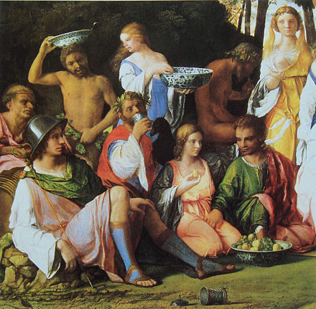
Introduction
Each piece of porcelain is unique.
There are never two which are identical.

Slide 3
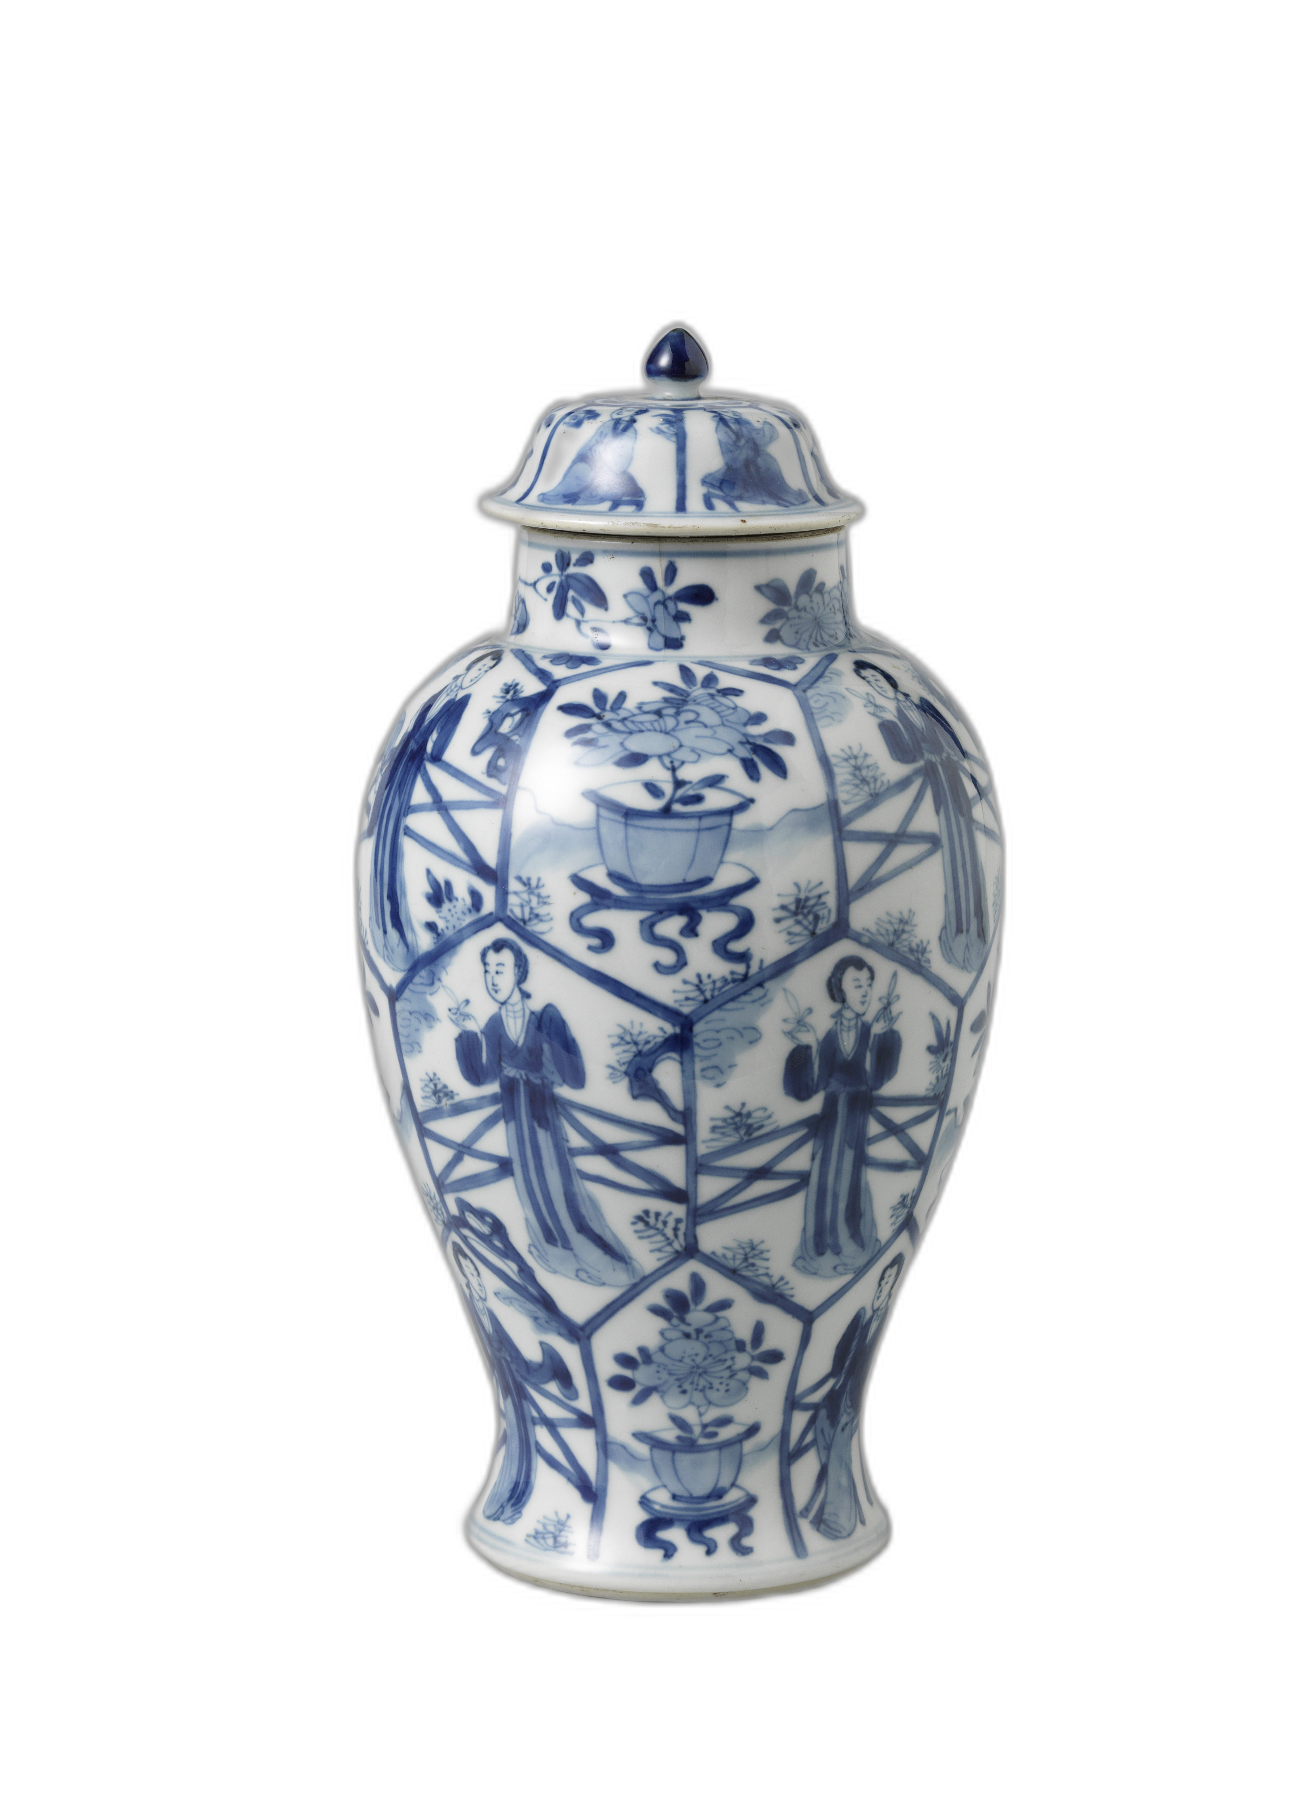
Chinese Porcelain in Europe(1)
Arrival of Chinese porcelain in Europe
Late 16th century through trade and diplomatic missions (Pierson, 2012)
Highly valued for its artistic and historical significance (Finlay, 2010)

Slide 4
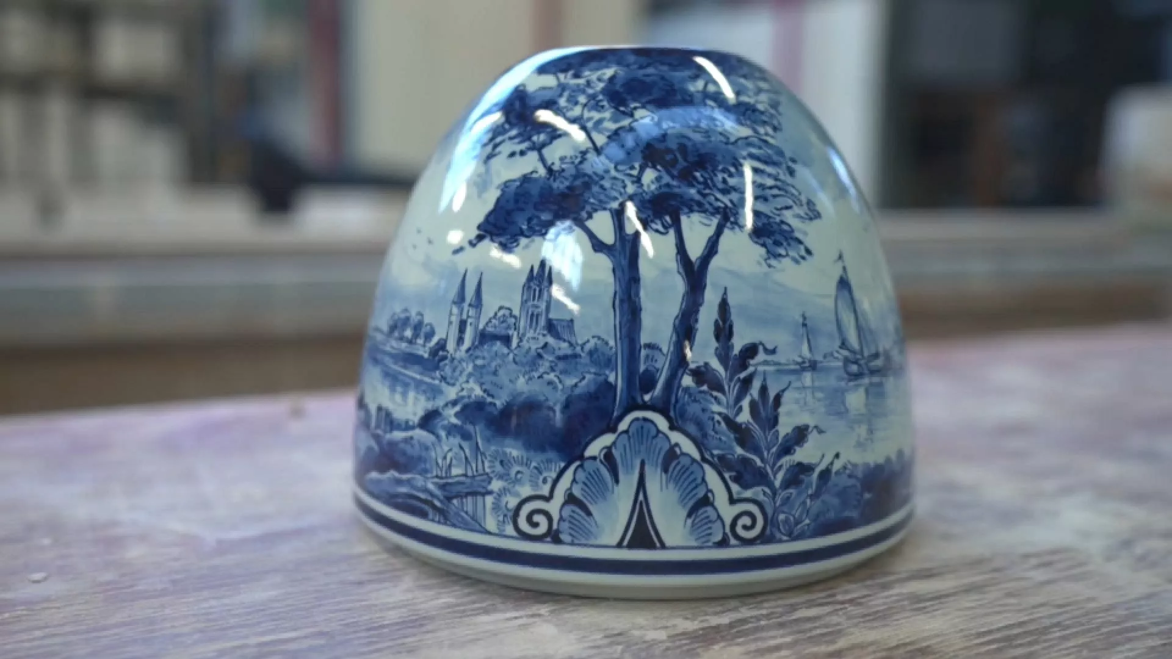
Chinese Porcelain in Europe(2)
European fascination and replication attempts
Efforts to understand and reproduce Chinese porcelain (Zumbulyadis, 2010)
Development of Delftware in the Netherlands (Odell, 2018; Sch¨onfeld, 1998)

Slide 5
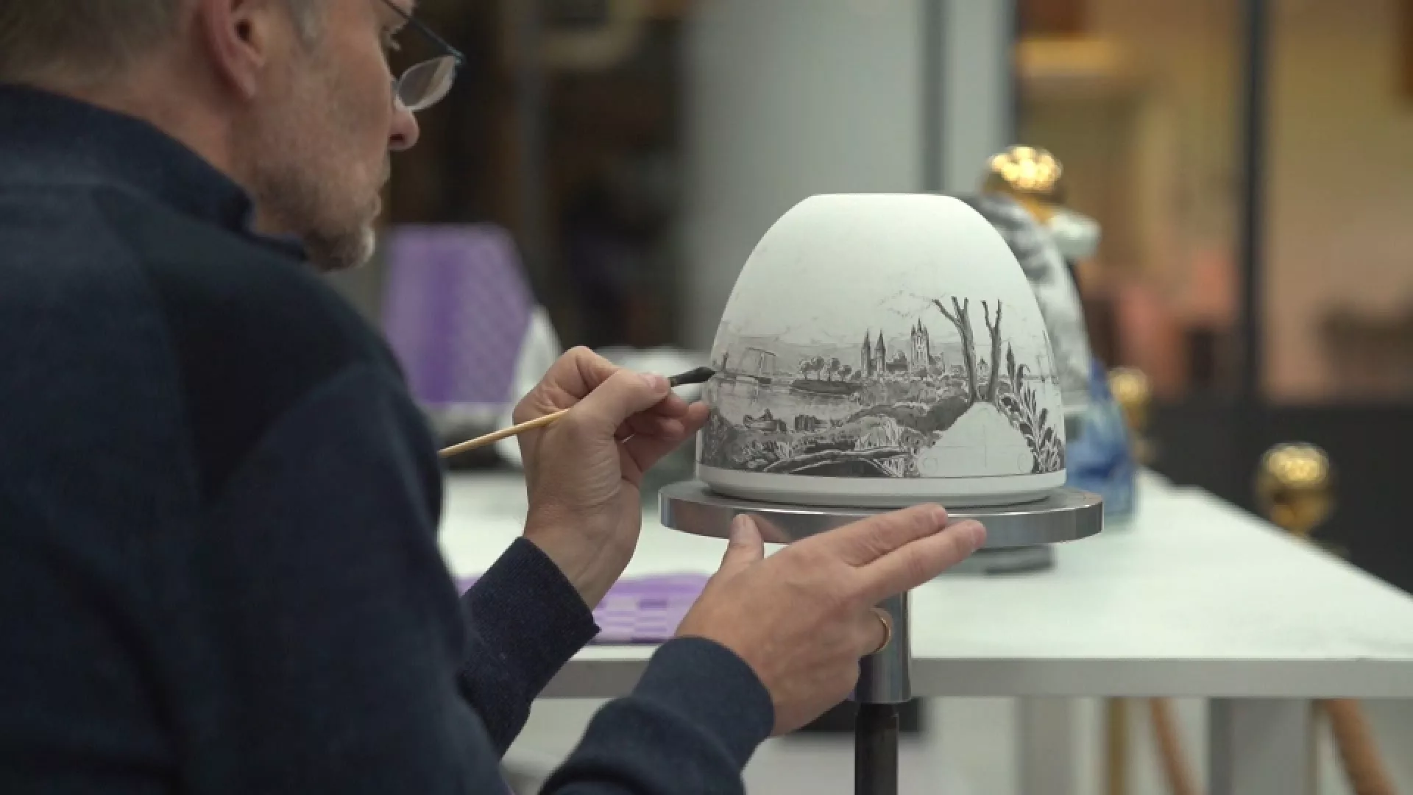
Chinese Porcelain in Europe(3)
Influence on European art and culture
Impact on aesthetics, etiquette, and ornamentation (Collins, 2000)
Impact on porcelain-making and painting techniques
Reflection of power relations and cultural capital (Wu, 2021)

Slide 6

Europeana Platform(1)
What is Europeana?
A digital platform for cultural heritage, launched in 2008 (Purday, 2009)
Provides access to millions of digital objects from European libraries, museums, archives, and collections (Europeana Foundation, 2021)
Mission and Objectives
To promote and facilitate the discovery, sharing, and reuse of cultural heritage resources across Europe (Europeana Foundation, 2021)
To support cultural heritage institutions in digitizing, preserving, and sharing their collections (Verwayen et al., 2011)
To foster collaboration and knowledge exchange among cultural heritage professionals and researchers (Europeana Pro, 2021)

Slide 7
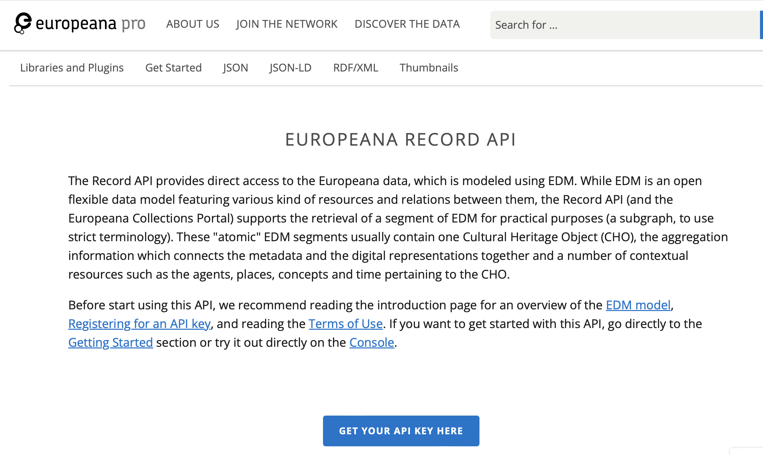

Europeana Platform(2)
API and Data Services
Offers a RESTful API for programmatic access to Europeana data (Europeana Pro, 2021)
Supports the development of innovative applications, visualizations, and research projects (Concordia et al., 2010)

Slide 8
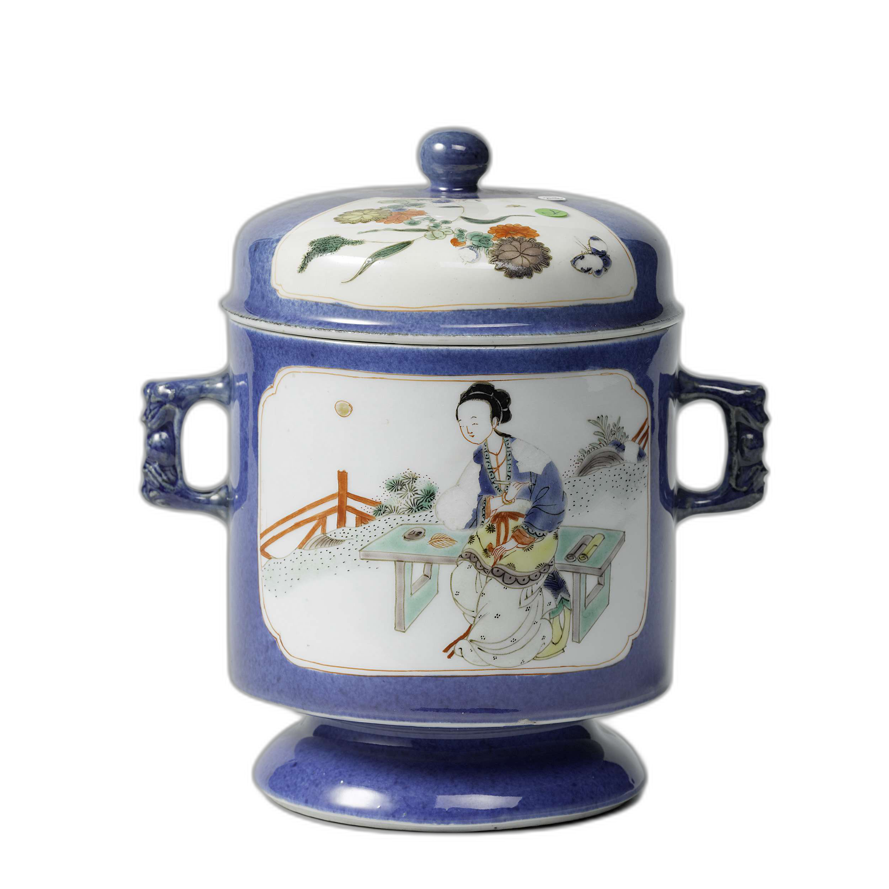
Collections from Europeana Platform
The Main Database

Slide 9
The Preservation of Chinese Porcelain in Europe: Challenges and Opportunities
Issues in documentation and interpretation
Lack of standardized terminology and classification systems (Wei et al., 2022)
Insufficient understanding of cultural context and production techniques (Ting, 2008)
Display and accessibility challenges
Limited physical space and concerns about object preservation (Ting, 2008)
Need for innovative digital solutions to enhance engagement and accessibility (Bekele et al., 2018)

Slide 10
Digital Cultural Heritage Management
Issues in metadata quality and interoperability
Lack of standardized metadata schemas across institutions (Korro Bañuelos et al., 2021)
Need for ontology-based multilingual terminology specially for Chinese ceramics (Wei et al., 2022)
Importance of digital tools
Preserving, studying, and disseminating cultural heritage (Bekele et al., 2018)
Enhancing public engagement and remote access to collections (Bearman & Trant, 2002)

Slide 11
Ontology and Metadata for Digital Cultural Heritage
Importance of ontologies for knowledge representation
Formal, explicit specification of shared conceptualizations (Studer et al., 1998)
Facilitating data integration, linking, and retrieval (Hyvönen, 2012)
Metadata standards and models
CIDOC Conceptual Reference Model (CRM) for cultural heritage documentation (Doerr, 2003)
Europeana Data Model (EDM) as a leading example (Charles & Isaac, 2015)
Challenges in cross-cultural metadata representation (Liew, 2005)
Metadata visualization for user engagement
Enhancing public understanding and interaction with cultural heritage (Bearman & Trant, 2002)
Enabling virtual exhibitions and remote access to collections (Sylaiou et al., 2010)

Slide 12
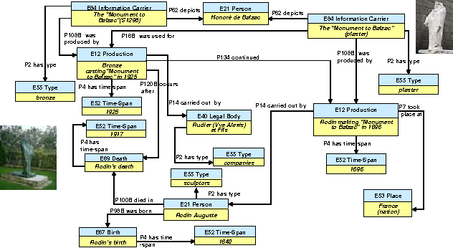
CIDOC Conceptual Reference Model (CRM)

Slide 13
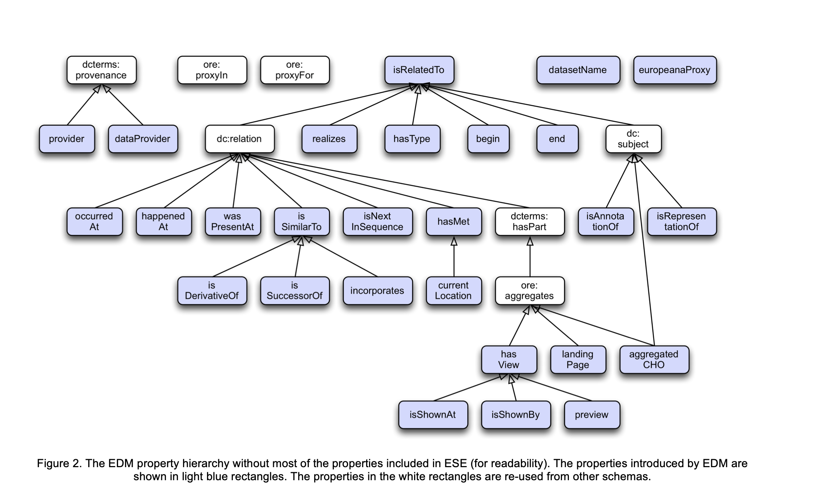
Europeana Data Model (EDM)

Slide 14
Thesis Objectives(1)
Develop an ontology-based metadata framework
Incorporate findings from analysis of existing metadata standards (Doerr et al., 2007; Charles & Isaac, 2015)
Identify core metadata elements for Chinese porcelain in Europe (Wei, 2020)
Create a comprehensive and adaptable metadata schema (Wijesundara & Sugimoto, 2018)

Slide 15
Thesis Objectives(2)
Conduct a case study on Chinese female images
Examine the portrayal of Chinese female subjects on European-made porcelain
Analyze aspects such as cultural appropriation and hybrid aesthetics (Gerritsen & McDowall, 2012)
Create a website to present research outcomes
Enhance accessibility and engagement with the research (Purificato & Rinaldi, 2018)
Develop interactive visualizations for metadata exploration (Dud´aˇs et al., 2018)
Ensure user-centered design and compliance with digital humanities principles (Bekele et al., 2018)

Slide 16
Methodologies

Slide 17
Ontology Development - Analysis and Design
Analysis of existing metadata standards
Review of cultural heritage metadata schemas (e.g., Dublin Core, VRA Core, EDM, CRM) (Baca, 2016)
Examination of porcelain-specific metadata frameworks (Wei et al., 2022)
Identification of core metadata elements
Selection based on applicability, flexibility, and compatibility (Wijesundara & Sugimoto, 2018)
Coverage of management, descriptive, resource, and usage aspects (Wijesundara & Sugimoto, 2018)
Design of "Chinese Porcelain in Europe" ontology
Development using Protégé ontology editor (Musen, 2015)
Definition of classes, properties, and relationships (Noy & McGuinness, 2001)
Incorporation of existing ontologies and models (e.g., CIDOC CRM, EDM) (Doerr, 2003; Charles & Isaac, 2015)

Slide 18
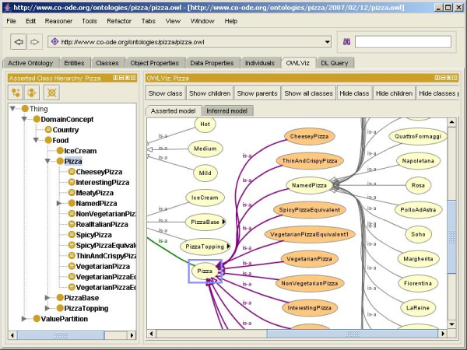

Protégé ontology editor
An open-source ontology editor and knowledge management system
Developed by the Stanford Center for Biomedical Informatics Research (BMIR) (Protégé, 2021)
Supports the creation, visualization, and manipulation of ontologies in various formats, such as OWL and RDF

Slide 19
Knowledge Map

Slide 20
Ontology Development - Population and Validation
Selection of representative samples
Identification of diverse and significant objects from the Europeana collection
Consideration of various attributes, such as decoration, technique, and period (Wei et al., 2022)
Creation of ontology instances
Modeling of selected objects using the defined classes and properties (Noy & McGuinness, 2001)
Enrichment of instances with metadata from Europeana and other sources (Charles & Isaac, 2015)
Validation and refinement
Testing of the ontology's structure and comprehensiveness (Poveda-Villalón et al., 2012)
Iterative improvements based on domain expert feedback and data quality assessment (Zaveri et al., 2016)

Slide 21
Case Study Analysis
Selection of Chinese female images
Focus on European-made Chinese-style porcelain objects (Pierson, 2012)
Exploration of cultural appropriation and hybrid aesthetics (Gerritsen & McDowall, 2012)
Color analysis
Extraction and quantification of color information from selected images
Use of Python libraries for data processing and visualization (e.g., OpenCV, Matplotlib)
Interpretation and discussion
Examination of color distribution patterns and their cultural significance (Finlay, 2010)
Consideration of the influence of Orientalist perspectives and stereotypes (Said, 1978)

Slide 22
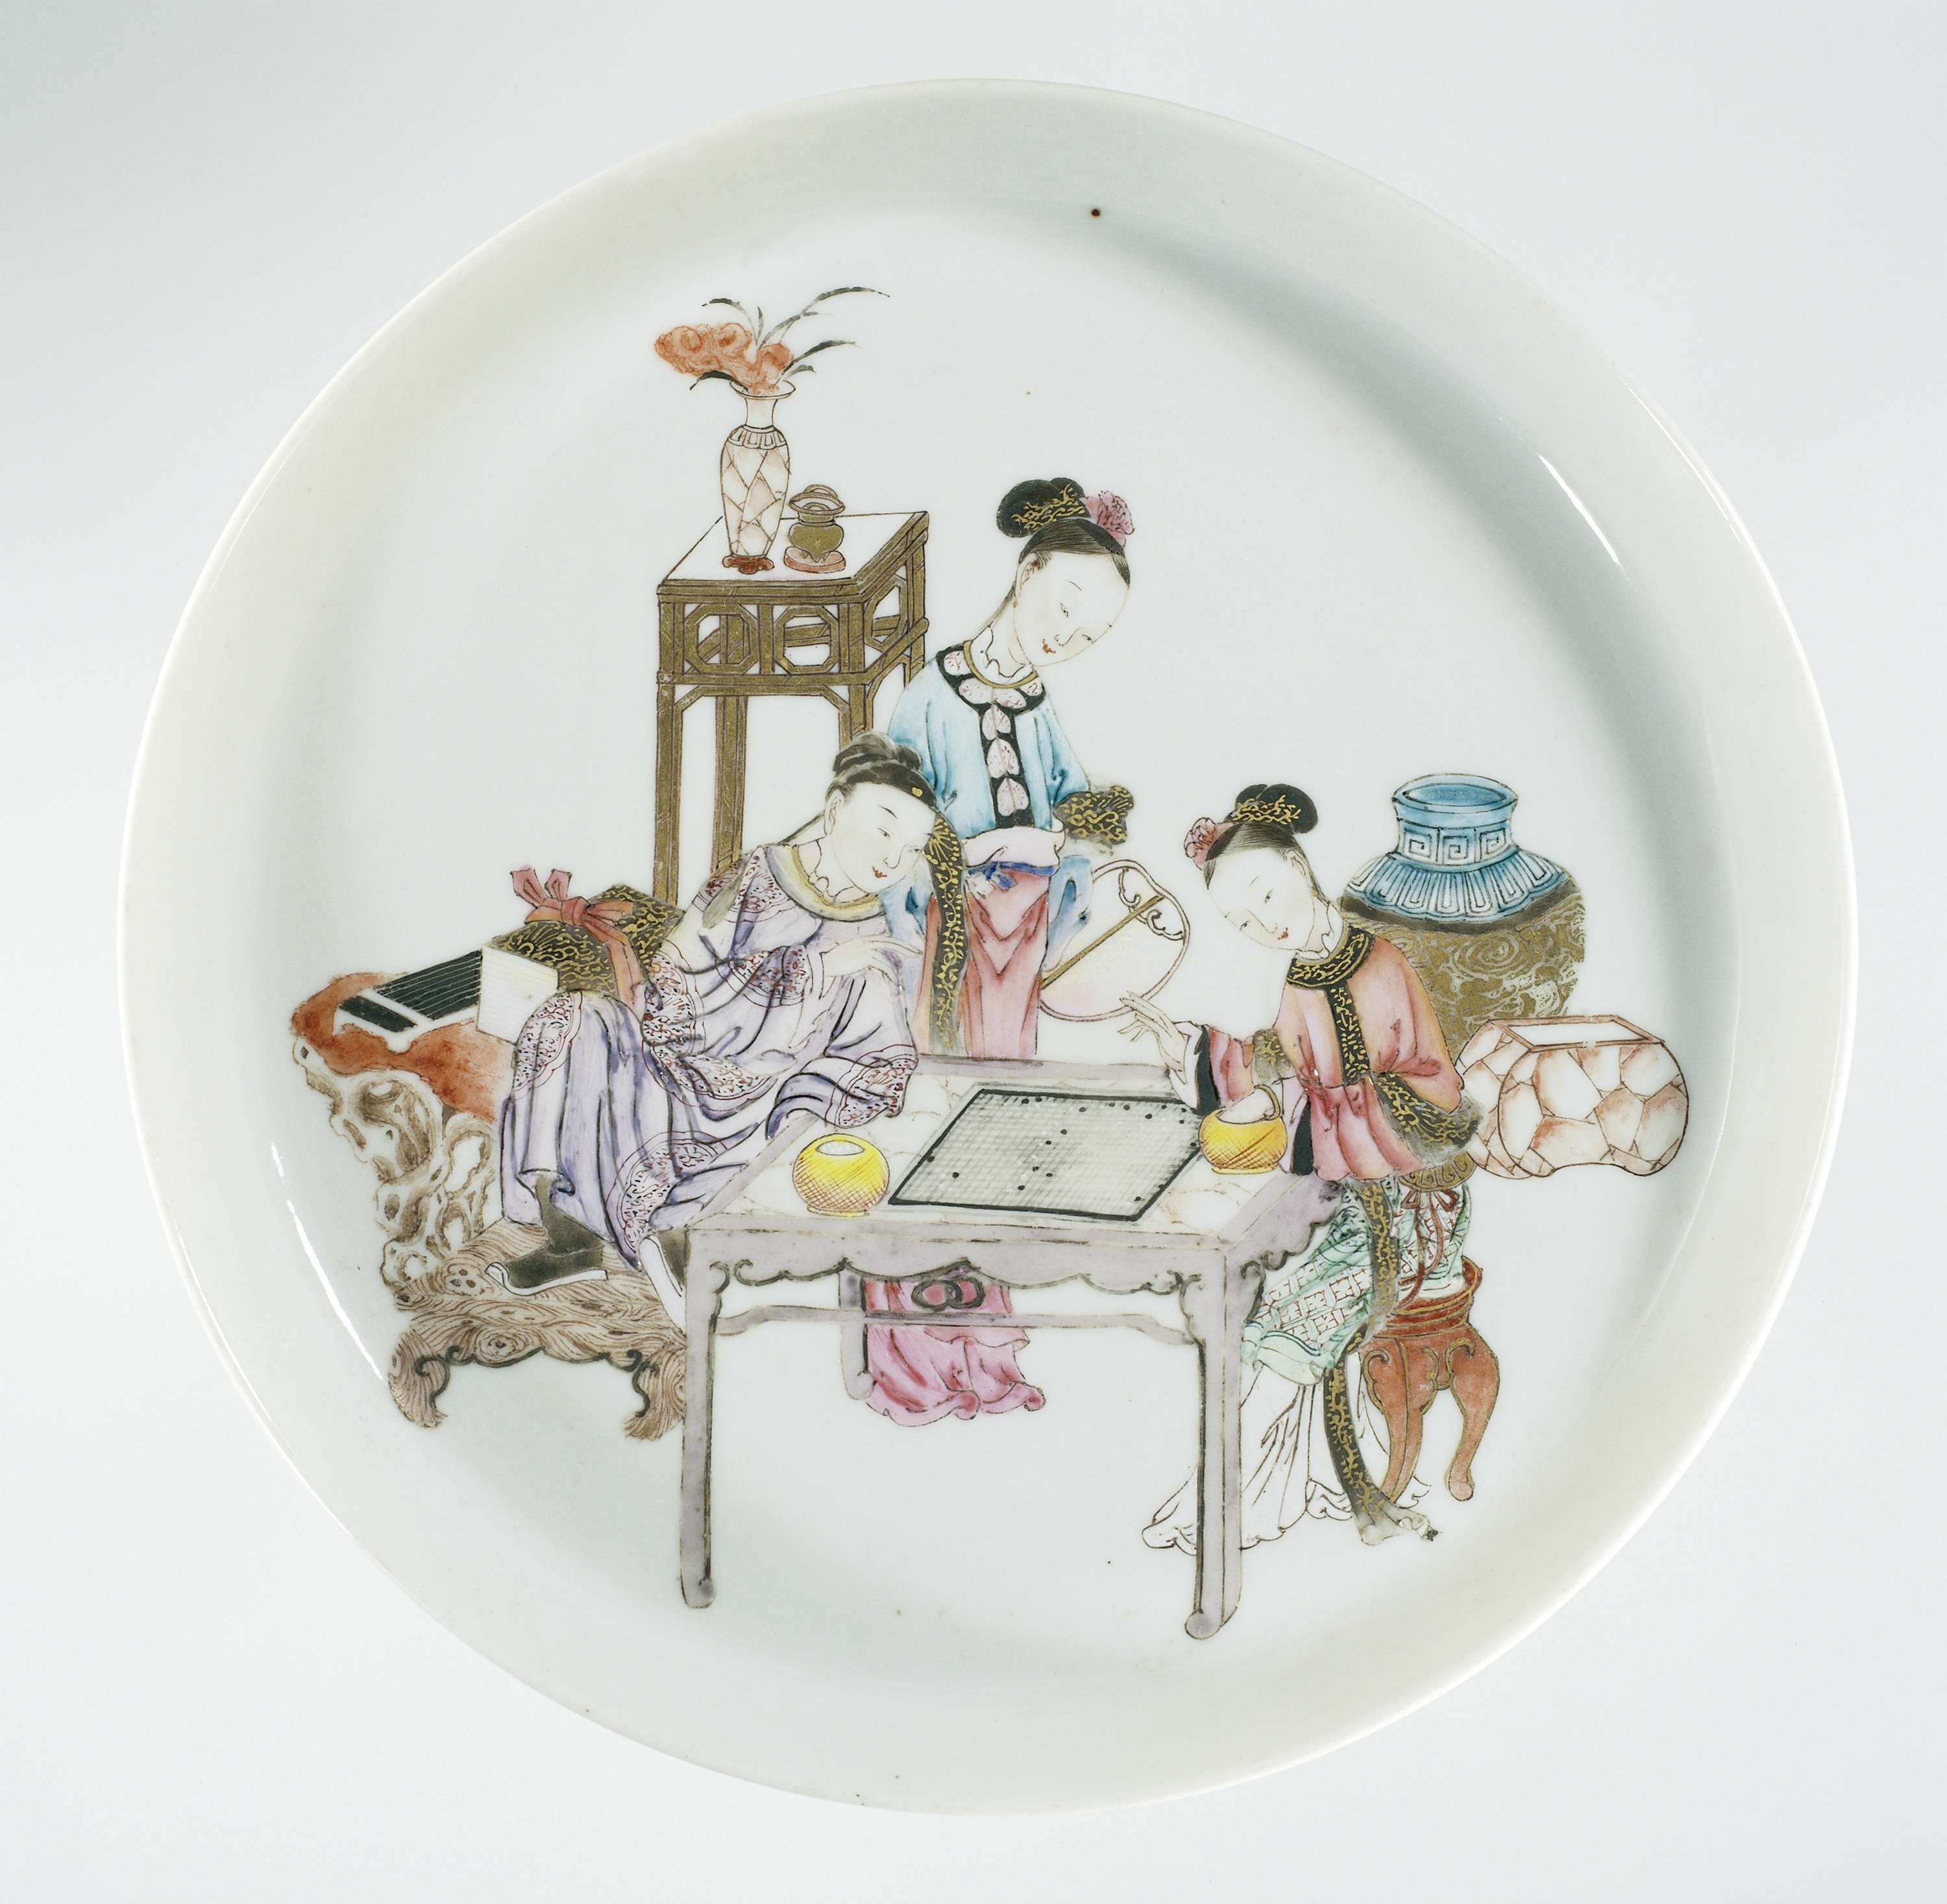
Color Analysis
Extraction and quantification of color information from selected images
Use of Python libraries for data processing and visualization (e.g., OpenCV, Matplotlib)

Slide 23
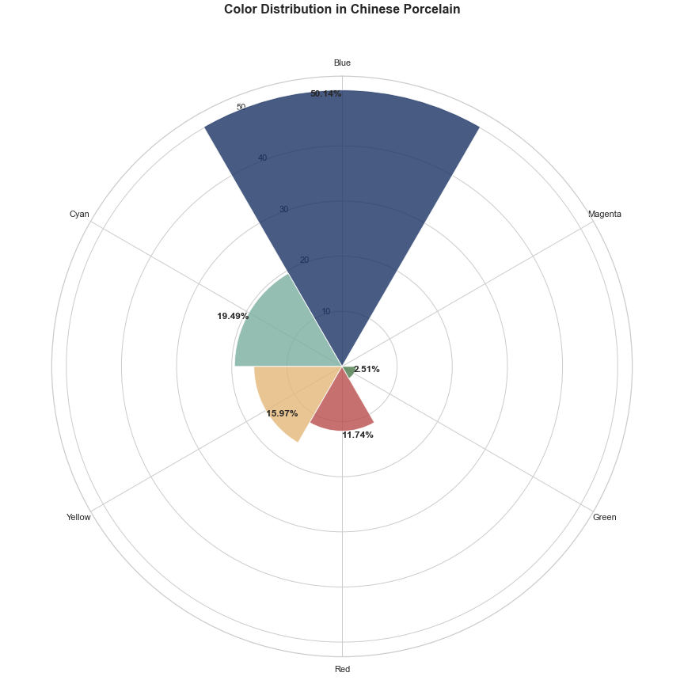
Color Analysis-Process
Extraction and quantification of color information from selected images
Use of Python libraries for data processing and visualization (e.g., OpenCV, Matplotlib)

Slide 24
Web Development
Design principles and objectives
Emphasis on accessibility, intuitive navigation, and user engagement
Adherence to web development best practices and standards
Website structure and components
Creation of HTML, CSS, and JavaScript files for each main section
Integration of interactive visualizations using D3.js and Chart.js libraries
Deployment and testing
Hosting of the website on a reliable platform
Evaluation of the website's performance, responsiveness, and compatibility

Slide 25
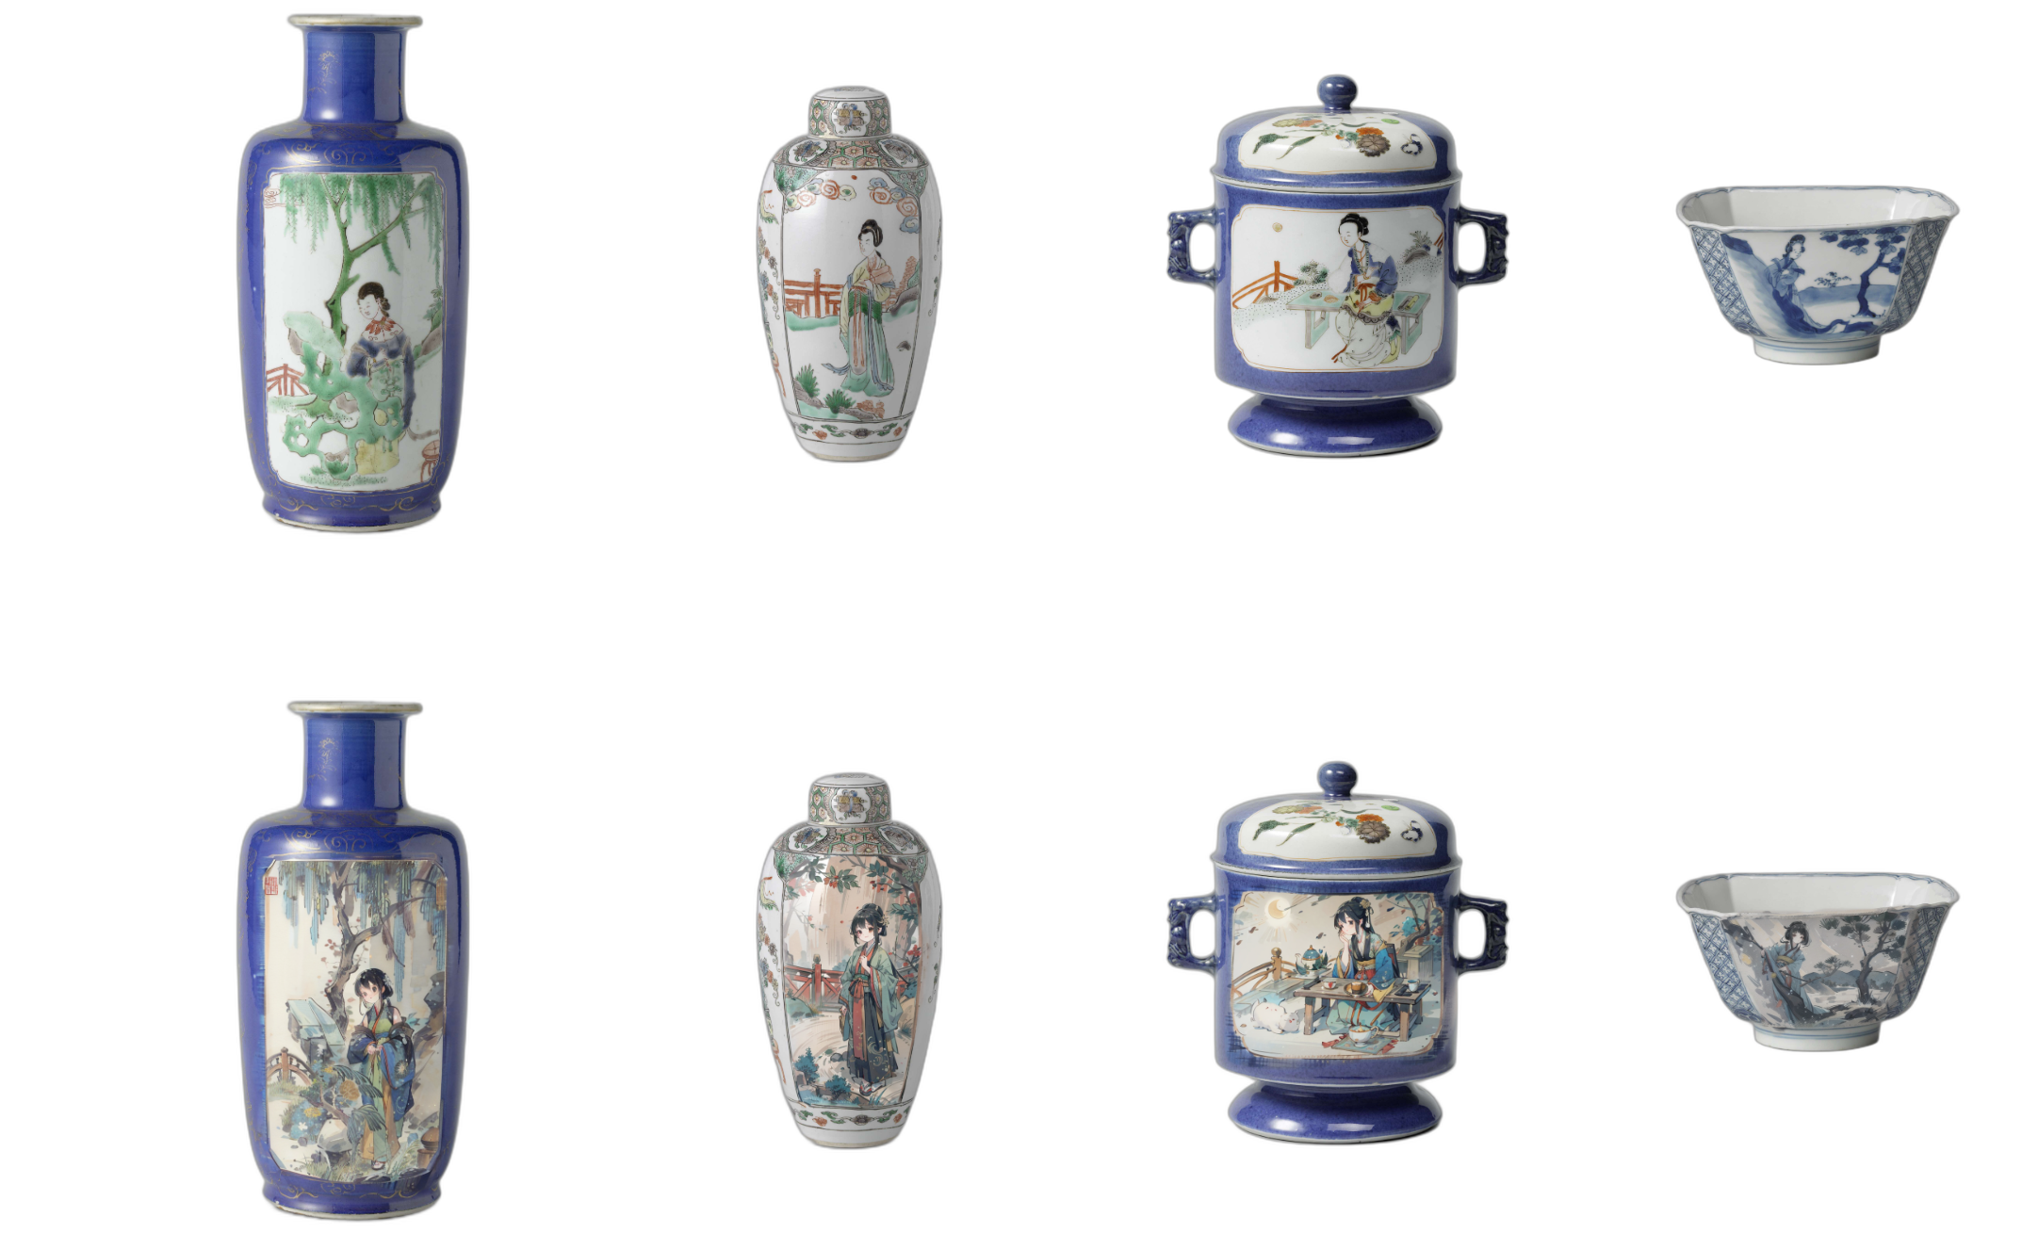
Bringing Porcelains to ALIVE
Selected representative images of Chinese porcelain from the Europeana collection
Preprocessed the images and extracted key visual features and metadata
Formulated text prompts describing the desired style, colors, and motifs (e.g., "traditional Chinese porcelain with floral patterns")
Fine-tuned the Stable Diffusion model using a specialized LoRA (Low-Rank Adaptation) approach
Generated new images by passing the text prompts through the fine-tuned model

Slide 26
Results and Discussion
Visualized and Presented through
Main Page

Slide 27
Acknowledgements
Supervisor: Prof. dr. Frederik Truyen
Co-supervisor: Prof. dr. Katrien Verbert

Slide 28
Questions?

Slide 29
THANK YOU

